Slide 1
In-Situ Lunar Resource Utilization: A Lunar Exploration Program Architecture to Establish Propellant Manufacturing Capability at the Lunar South Pole
ENAE 791 Final Project
Spring 2020
Joseph Carpinelli
John Furumo

Slide 2
Contents
Background
Program Overview
Mission Profiles
Δv Budget
SpaceBus
Overview
Crew transport configuration
Sizing trade study
Tanker configuration
Earth-Moon logistics
Lunar Landing Vehicle
Overview
Configuration
Sizing trade study
Earth-Moon logistics
Earth Launch Vehicle
Crew Launch & Entry Vehicle
Program Cost Estimates
Program Outline
Conclusions
Future Studies
Back-up slides

Slide 3
Background
In recent years, NASA and the international space community have expressed great interest in returning human crews to the lunar surface as part of a larger goal of expanded human exploration throughout the solar system.
Rather than another one-off visit for ‘flags and footprints’, there is increasing impetus to establish a permanent human presence in cislunar space. This will require greater infrastructure development to foster a nascent cislunar economy to fund and sustain such activity. A focal point of such an economy is the extraction of resources from the lunar crust, such as minerals and water ice that could be used to produce hydrogen and oxygen for rocket propulsion.
This project proposes a large-scale exploration program to create a propellant depot at the lunar south pole in order to demonstrate the ability to perform meaningful in-situ resource utilization (ISRU) beyond Earth. Such a program will aim to lay the groundwork for the infrastructure necessary for humans to work and inhabit cislunar space, and eventually travel beyond.

Slide 4
Program Overview
Phase I: Exploration and Site Selection
The initial missions to the lunar surface will be robotic exploration vehicles to seek out deposits of water ice at the lunar south pole. These are similar in concept to NASA’s cancelled Resource Prospector mission and the proposed VIPER mission.
Assuming a suitable site for extraction and processing of water ice is found at the lunar south pole, supply delivery missions will follow to deliver mining and processing equipment as well as prefabricated modules for the propellant production plant, to be powered by the constant solar power available at the lunar poles.
Phase II: Cislunar Transportation Network Setup
Following the selection of a lunar surface site for operations and delivery of initial supplies to that site, the next phase in the program will establish the network to transport crew and supplies to the lunar surface. This network has two primary components:
SpaceBus vehicle: crew transport with propulsion module to provide Δv needed to travel between a low Earth parking orbit (LEO) and a low lunar polar parking orbit (LLO). This vehicle is completely reusable for the duration of the program.
Lunar Landing Vehicle (LLV): crew transport and propellant tanker to deliver liquid hydrogen and liquid oxygen propellants produced at lunar surface propellant plant to LLO for refueling of SpaceBus for another round trip to Earth and back to the moon. This vehicle is also completely reusable for the duration of the program.
These vehicles will be launched empty or nearly empty of propellants to LEO using the Earth Launch Vehicle (ELV) which is notionally a single-stage-to-orbit (SSTO) completely expendable launch vehicle.
For initial staging of these vehicles in LLO, they must be fueled in LEO using propellants launched from Earth. Modified SpaceBus tanker modules will be launched to LEO using the ELV where they will rendezvous and dock with the crew transport vehicles and transfer enough propellants to enable each vehicle to make the one-way trip to LLO.
Phase III: Propellant Production Operations
Assuming that limitations of current robotic technology preclude the lunar propellant plant from being constructed and brought online in a reasonable timeframe in the near future, human crews will be ferried to the lunar surface to perform this function. The notional quantity of these missions to establish the propellant production operations is five.
Crews of four will launch to LEO in the Crew Launch and Entry Vehicle (CLEV) using the ELV. In LEO the CLEV will rendezvous and dock with the SpaceBus and the crew will transfer from the former to the latter vehicle for the trip to the moon. The CLEV will remain in LEO for the duration of the crew’s mission to the lunar surface. After reaching LLO, the SpaceBus with rendezvous and dock with the LLV and the crew will again transfer to the new vehicle before descending to the lunar surface for a two-week stay to perform ISRU duties.
After completing the lunar surface mission, the crew will ascend to LLO in the LLV which will be completely refueled at this point. The LLV will rendezvous and dock with the SpaceBus in LLO and transfer both the crew and propellant to it to fill its tanks for the trip back to Earth. Upon return from the moon in the SpaceBus vehicle, the crew will transfer back to the CLEV in LEO for Earth atmospheric entry, descent, and landing (EDL).

Slide 5
Mission Profiles
Phase I
Scout rover
Initial scouting missions performed by robotic lander and rover tandems that will seek out and identify optimal locations for mining and processing of lunar water ice
ISRU equipment staging
Uncrewed missions to send water ice mining and processing plant equipment to sites identified by scouting rovers ahead of crew arrival
Phase II
SpaceBus crew transport
One-time launch of reusable crew transport vehicle to LEO
Awaits first crewed mission in LEO prior to one-way trip to LLO
Lunar landing vehicle
One-time launch of reusable lunar landing vehicle to LEO
One-way trip to LLO to await first crewed landing on moon
SpaceBus tanker
Expendable tanker module launches to refuel SpaceBus crew transport or lunar landing vehicle in LEO
Phase III
Crew launch/return
Operational crew missions to establish ISRU water ice processing plant and demonstrate LH₂ and LO₂ production capabilities

Slide 6
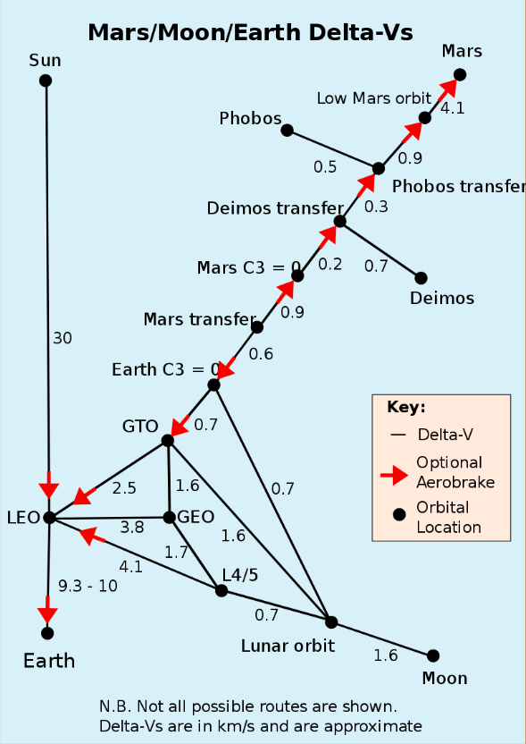
Δv Budget - Overview
Mission Maneuver | Δv Required (km/s) | Notes/Source
Launch | 9.0 | crude “Hohmann Transfer” method
 | 9.2 – 9.5 | Rule of thumb per Dr. Akin
 | 9.3 – 10 | [2]
Trans-Lunar Injection (TLI) | 5.02 | Sum of separate maneuvers Apogee raise: Δv = 2.47 km/s Plane change: Δv = 2.56 km/s
 | 3.90 | Combined maneuver
 | 4.04 | [2]
Lunar Orbit Injection (LOI) | 3.16 | Sum of separate maneuvers Apogee raise: Δv = 0.85 km/s Plane change: Δv = 2.31 km/s
 | 1.66 | Combined maneuver
Lunar descent/ascent | 1.63 | [1]
Trans-Earth Injection (TEI) | 0.90 | [2], assumes use of aerobraking
[1]
[1]: https://en.wikipedia.org/wiki/Delta-v#cite_note-marsdeltavs-5
[2]: https://web.archive.org/web/20070701211813/http://www.pma.caltech.edu/~chirata/deltav.html

Slide 7
Δv Budget - Design
Mission Maneuver | Δv Required (km/s) | Notes/Source
SpaceBus Earth-Moon Round Trip | 10.52 | Used to size SpaceBus propellant tankage TLI: Δv = 4.04 km/s [2] LOI (plane change only): Δv = 2.31 km/s LOI (reverse plane change): Δv = 2.31 km/s TEI: Δv = 0.90 km/s [2] +10% factor of safety
Trans-Lunar Injection (TLI) | 6.985 | Used to quantify one-way propellant loading for LEO – LLO trip (SpaceBus and LLV) Equatorial TLI: Δv = 4.04 km/s Plane change: Δv = 2.31 km/s +10% factor of safety
Lunar Descent/Ascent | 1.797 | Used to size LLV propellant tankage Descent/ascent from/to LLO: Δv = 1.63 km/s +10% factor of safety
[1]
[1]: https://en.wikipedia.org/wiki/Delta-v#cite_note-marsdeltavs-5
[2]: https://web.archive.org/web/20070701211813/http://www.pma.caltech.edu/~chirata/deltav.html

Slide 8
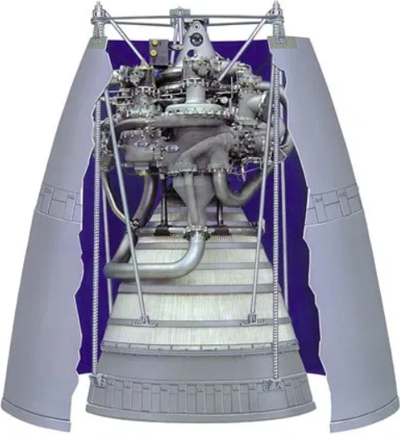
SpaceBus Overview
Crew Transport
Crew Module
Initial concept: ISS Destiny module
14.5 MT in total [1]
SpaceBus required dry mass (first iteration): 19.9 MT
Revised concept: NASA JSC-26098 guidelines
Crew size: 4
7 days of life support
Enough for round-trip from Earth to Moon and back in case of abort mode that prevents lunar landing
SpaceBus dry mass (final iteration): 13.5 MT
Propulsion Module
1x RL-10B-2 engine + plumbing
Propellants: Liquid hydrogen and liquid oxygen
Oxygen tank pressurization system
4x He COPV (26” diameter) @ 4000 psia
Based on Centaur pressurization system [2]
Structural elements
Propellant tanks + insulation
Thrust structure
Fairings
Electrical elements
Avionics
Wiring
Tanker
Same as Crew Transport configuration except:
No Crew Module
No rocket engine or associated hardware
Propellant tanks and supporting structure, systems only
RL-10B-2 [3]
Most efficient production rocket engine in use
Thrust: 110100 N
Dry mass: 301.2 kg
Specific impulse: 465.5 s
Exit velocity: 4.565 km/s
Mixture ratio: 5.88
[1]: https://en.wikipedia.org/wiki/Destiny_(ISS_module)
[2]: https://www.ulalaunch.com/docs/default-source/upper-stages/the-centaur-upper-stage-vehicle.pdf
[3]: https://en.wikipedia.org/wiki/RL10

Slide 9
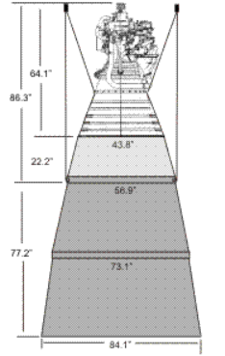
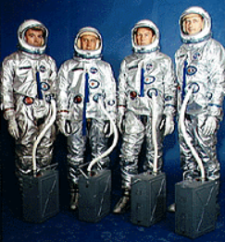
SpaceBus Crew Transport
29.69 m
He
LH₂
LO₂
4 m
He
21.11 m
8.58 m
2.36 m
1x RL-10B-2
Engine Mass = 301.2 kg
Plumbing Mass = 150.6 kg
Fuel
Mass = 17649 kg
Volume = 248.6 m³
Tank Mass = 2259.6 kg
Oxidizer
Mass = 103780 kg
Volume = 91.0 m³
Tank Mass = 1106.9 kg
Crew Module
Mass = 6043 kg
Volume = 29.63 m³
Miscellaneous Mass
Fairings = 993.7 kg
Avionics = 711.1 kg
Wiring = 907.1 kg
Thrust structure = 28.1 kg
Helium COPV = 101.5 kg
Propulsion Module
Dry Mass = 7445 kg
Propellant Mass = 121429 kg
Overall
Dry Mass = 13488 kg
Wet Mass = 134910 kg
Launch Mass = 62265 kg
Note: figures not to scale

Slide 10
SpaceBus Sizing
 | SpaceBus diameter (m) | 4 | 5 | 6
Fuel: LH₂ | Mass (kg) | 17649 | 18593 | 20080
 | Volume (m³) | 248.6 | 261.9 | 282.8
 | Tank mass* (kg) | 2259.6 | 2380.4 | 2570.8
 | Tank length (m) | 21.11 | 15.00 | 12.00
Oxidizer: LO₂ | Mass (kg) | 103780 | 109330 | 118070
 | Volume (m³) | 91.0 | 95.9 | 103.6
 | Tank mass* (kg) | 1106.9 | 1166.2 | 1259.4
 | Tank length (m) | 8.58 | 6.55 | 5.66
Misc. | Fairing mass (kg) | 993.7 | 1660.1 | 2525.0
 | Avionics mass (kg) | 711.1 | 724.6 | 745.0
 | Wiring mass (kg) | 907.1 | 859.4 | 849.8
Overall | Dry mass (kg) | 13488 | 14209 | 15346
 | Wet mass (kg) | 134910 | 142130 | 153500
 | Length (m) | 32.05 | 23.06 | 18.71
*does not include tank insulation

Slide 11
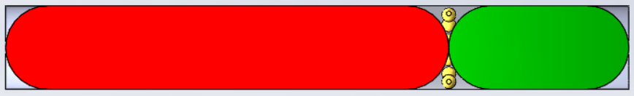
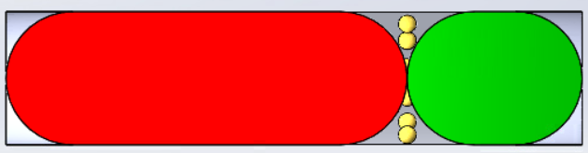
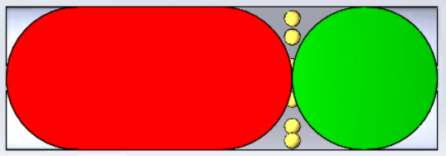
29.69 m
4 m
21.55 m
5 m
17.66 m
6 m

Slide 12
SpaceBus Tanker
29.69 m
He
LH₂
LO₂
4 m
He
21.11 m
8.58 m
Fuel
Mass = 1894.6 kg
Volume = 248.6 m³
Tank Mass = 2259.6 kg
Oxidizer
Mass = 11140 kg
Volume = 91.0 m³
Tank Mass = 1106.9 kg
Miscellaneous Mass
Fairings = 993.7 kg
Avionics = 711.1 kg
Wiring = 907.1 kg
Helium COPV = 101.5 kg
Overall
Dry Mass = 6965.2 kg
Propellant Mass = 13034.8 kg
Wet Mass = 20000 kg
Note: figures not to scale

Slide 13
SpaceBus Propellant Transfer in LEO
Due to the Earth launch vehicle (ELV) being optimally sized for the crew launch and entry vehicle (CLEV), the SpaceBus crew transport must be launched nearly empty of propellants.
ELV payload to LEO: 20000 kg
SpaceBus crew transport dry mass: 13488 kg
Residual propellant mass: 6512 kg
Expendable SpaceBus tanker modules will be launched to fuel the SpaceBus crew transport vehicle in LEO.
Round-trip
Total Δv required: 10.516 km/s
Total propellant required: 121430 kg
Net propellant required: 114918 kg
Tanker flights required to fuel SpaceBus crew transport: 9
One-way
Total Δv required: 6.985 km/s
Total propellant required: 48777 kg
Net propellant required: 42265 kg
Tanker flights required to fuel SpaceBus crew transport: 4

Slide 14
Lunar Landing Vehicle Overview
Crew Transport
Crew Module
Based on NASA JSC-26098 guidelines
Crew size: 4
14 days of life support
Enough for 2-week stay on lunar surface
Propulsion Module
4x RL-10B-2 engines + plumbing
Propellants: Liquid hydrogen and liquid oxygen
Oxygen tank pressurization system
4x He COPV (26” diameter) @ 4000 psia
Based on Centaur pressurization system [1]
Structural elements
Propellant tanks + insulation to store:
Ascent propellant
Descent propellant
Transfer propellant
Thrust structure
Fairings
Landing legs
Electrical elements
Avionics
Wiring
Lunar Liftoff Analysis
LLV wet mass: 229 MT
Lunar g = 1.6 m/s²
LLV weight on moon: 372 kN
Number of engines required for liftoff: 4
RL-10B-2 [2]
Most efficient production rocket engine in use
Thrust: 110100 N
Dry mass: 301.2 kg
Specific impulse: 465.5 s
Exit velocity: 4.565 km/s
Mixture ratio: 5.88
[1]: https://www.ulalaunch.com/docs/default-source/upper-stages/the-centaur-upper-stage-vehicle.pdf
[2]: https://en.wikipedia.org/wiki/RL10

Slide 15

Lunar Landing Vehicle
4 m
Miscellaneous Mass
Fairings = 993.7 kg
Avionics = 860.9 kg
Wiring = 1337.5 kg
Thrust structure = 112.3 kg
Helium COPV = 101.5 kg
Landing legs = 1000 kg
Overall
Dry Mass = 22348 kg
Propellant Mass = 206716 kg
Wet Mass = 229064 kg
Crew Module
Mass = 8944.5 kg
Volume = 49.63 m³
3.95 m
Oxidizer
Mass = 176671 kg
Volume = 155.0 m³
Tank Mass = 2077.3 kg
LO₂
13.67 m
Propulsion Module
Dry Mass = 7445 kg
Propellant Mass = 121429 kg
Fuel
Mass = 30045 kg
Volume = 423.2 m³
Tank Mass = 5113.7 kg
LH₂
35.01 m
4x RL-10B-2
Engine Mass = 1204.8 kg
Plumbing Mass = 602.4 kg
Note: figures not to scale

Slide 16
LLV Sizing
 | LLV diameter (m) | 4 | 5 | 6
Fuel: LH₂ | Mass (kg) | 30045 | 30100.2 | 30217.3
 | Volume (m³) | 423.2 | 423.9 | 425.6
 | Tank mass* (kg) | 5113.7 | 4905.9 | 4794.4
 | Tank length (m) | 35.01 | 23.26 | 17.05
Oxidizer: LO₂ | Mass (kg) | 176671 | 176994 | 177681
 | Volume (m³) | 155.0 | 155.3 | 155.9
 | Tank mass* (kg) | 2077.3 | 2056.8 | 2054.2
 | Tank length (m) | 13.67 | 9.57 | 7.51
Misc. | Fairing mass (kg) | 993.7 | 1660.1 | 2525.0
 | Avionics mass (kg) | 860.9 | 861.8 | 863.8
 | Wiring mass (kg) | 1337.5 | 1213.9 | 1132.6
Overall | Dry mass (kg) | 22348 | 22664 | 23336
 | Wet mass (kg) | 229064 | 229750 | 231230
 | Length (m) | 52.63 | 35.35 | 26.32
*does not include tank insulation

Slide 17
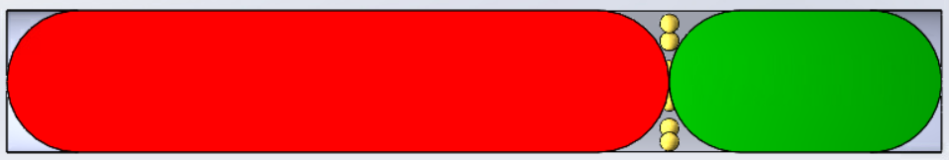
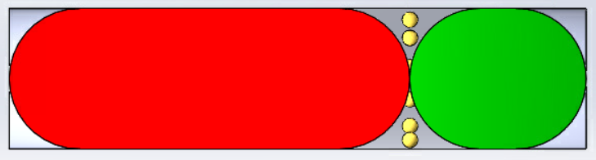
48.68 m
4 m
32.83 m
5 m
24.56 m
6 m

Slide 18
LLV Propellant Transfer in LEO
Due to the Earth launch vehicle being optimally sized for the crew launch and entry vehicle (CLEV), the lunar landing vehicle must be launched empty of propellants.
Launch vehicle payload to LEO: 20000 kg
LLV dry mass: 22348 kg
Expendable SpaceBus tanker modules will be launched to fuel the LLV in LEO.
Round-trip
Total Δv required: 10.516 km/s
Total propellant required: 206716 kg
Tanker flights required to fuel SpaceBus crew transport: 16
One-way
Total Δv required: 6.985 km/s
Total propellant required: 136331 kg
Tanker flights required to fuel SpaceBus crew transport: 11

Slide 19
Earth Launch Vehicle
‘Big Dumb Booster’ concept
Broad Design Goals:
Use high flight and production rates to lower marginal flight cost
Take advantage of semi-modular design to increase flight and production rates
Use single-use SSTO to lower marginal flight cost

Slide 20
Earth Launch Vehicle: MER
MER optimized to minimize tank and insulation mass as a function of vehicle diameter
L/D ratio of approximately 9
Tank shape was modified to reduce required insulation
Cylindrical tanks with flat ends allow for less insulation, but are structurally less stable
Cylindrical tanks with semi-spherical ends are structurally sound, but require more insulation
Cylindrical tanks with rounded ends (“spherical cap” [1]) were chosen to allow for reduced insulation, and tank structural integrity
Stage uses 6 RS-25 engines
[1]: https://mathworld.wolfram.com/SphericalCap.html

Slide 21
ELV SSTO MER (6.5 m diameter)
 | Fuel Tank Shape | Flat Tank Edges | Spherical Edges | Rounded Edges
Fuel: LH₂ | Mass (kg) | 85790.09 | 87727.67 | 85936.88
 | Volume (m³) | 1208.31 | 1235.60 | 1210.38
 | Tank mass (kg) | 10983.55 | 11231.61 | 11002.34
 | Tank insulation mass | 2332.63 | 3209.25 | 3209.25
 | Tank length (m) | 35.41 | 48.07 | 37.45
Oxidizer: LO₂ | Mass (kg) | 514640.56 | 526366.00 | 515621.26
 | Volume (m³) | 451.53 | 461.72 | 452.30
 | Tank mass (kg) | 5490.57 | 5614.57 | 5500.00
 | Tank insulation mass | 386.57 | 716.58 | 410.18
 | Tank length (m) | 13.607 | 24.75 | 14.60
Misc. | Fairing mass (kg) | 3966.80 | 3966.79 | 3966.80
 | Avionics mass (kg) | 1272.99 | 1283.29 | 1273.77
 | Wiring mass (kg) | 2386.74 | 2626.91 | 2409.99
Overall | Initial Dry Mass (kg) | 60,887.53 | 60.89 | 60887.53
 | Dry mass (kg) | 50,821.64 (+16.5%) | 52,650.80 (+13.5%) | 60,960.32 (+16.3%)
 | Wet mass (kg) | 651,352.29 | 653,181.45 | 662,518.46
 | Length (m) (w/o engine, payload fairing) | 50.02 | 72.82 | 52.05

Slide 22
Earth Launch Vehicle: MER
0.325 m
52.05 m
LH₂
LO₂
6.5 m
6x RS-25
Engine Mass = 3526 kg
[1]
37.45 m
14.60 m
19.5 m
Fuel
Mass = 85,936.9 kg
Volume = 1210.4 m³
Tank Mass = 11002.3 kg
Oxidizer
Mass = 515,621.3 kg
Volume = 452.3 m³
Tank Mass = 5500.0 kg
Miscellaneous Mass
Fairings = 3966.8 kg
Avionics = 1273.8 kg
Wiring = 2410.0 kg
Overall
Dry Mass = 50,960 kg
Propellant Mass = 601,558 kg
Wet Mass = 652,518 kg
[1]: https://en.wikipedia.org/wiki/RS-25
Note: figures not to scale

Slide 23
Earth Launch Vehicle
Three launch configurations were included in the final analysis:
SSTO
Carries 25 tonne payload to ~9200 m/s
SSTO with two additional boosters
Parallel staging, boosters identical to core
Chi value of 0 (three cores thrust simultaneously)
Carries 73.7 tonne payload to ~9200 m/s
Two identical serial stages
Carries 66.7 tonne payload to ~9200 m/s

Slide 24
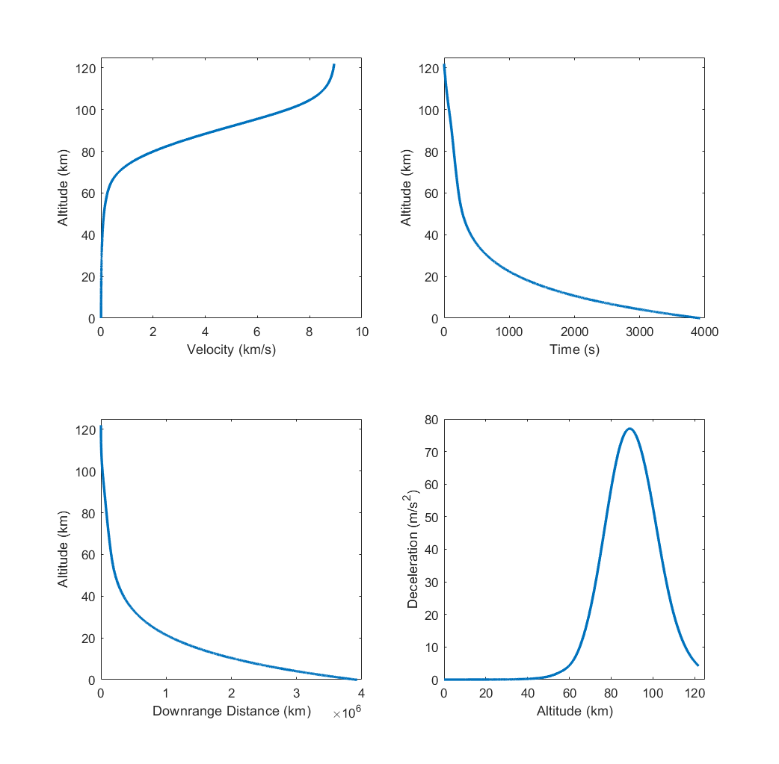
Crew Launch and Entry Vehicle
CLEV Ballistic Entry
The Crew Launch and Entry Vehicle (CLEV) is used to ferry the crew from Earth to LEO and back and is not intended for travel beyond. It provides life support functions for the crew during launch and entry, and remains in LEO in a low power mode while the crew is beyond LEO.
Attributes
Mass = 15000 kg
Heat shield diameter = 4 m
Ballistic coefficient = 994.7 kg/m²
L/D ratio = 0.25
C_{D} = 1.2
Peak deceleration = 7 g’s
Terminal velocity = 3.99 m/s
CLEV depiction

Slide 25
Program Outline: One-way
Launch # | Mission Profile | Notes
1 – 2 | Scout Rover | Notionally similar to NASA VIPER mission concept or CNSA Chang’e 4 mission
3 – 5 | ISRU equipment staging
6 | Lunar Landing Vehicle | LLV must safely reach LLO before first crew will depart LEO in SpaceBus
7 – 17 | SpaceBus Tanker | 11 tanker loads of propellant needed for round-trip LLV trip to LLO
18 | SpaceBus Crew Transport | Enough propellant loaded for round-trip to Moon
19 – 22 | SpaceBus Tanker | 4 tanker loads of propellant needed for round-trip SpaceBus trip to LLO
23 – 27 | Crew Launch/Return | CLEV transportation to LEO and back
Staging Crew Vehicles in LLO
One-way trip provided via partial propellant load
Abort modes possible only at selected points along the TLI, LOI, lunar descent/ascent, TEI trajectory sequence
27 total launches planned
30 launch vehicles planned for fabrication to provide development and test units
Marginal cost: $85M
15 total SpaceBus tanker modules required
Marginal cost: $29M

Slide 26
Program Outline: Round-trip
Launch # | Mission Profile | Notes
1 – 2 | Scout Rover | Notionally similar to NASA VIPER mission concept or CNSA Chang’e 4 mission
3 – 5 | ISRU equipment staging
6 | Lunar Landing Vehicle | LLV must safely reach LLO before first crew will depart LEO in SpaceBus
7 – 22 | SpaceBus Tanker | 16 tanker loads of propellant needed for round-trip LLV trip to LLO
23 | SpaceBus Crew Transport | Enough propellant loaded for round-trip to Moon
24 – 32 | SpaceBus Tanker | 9 tanker loads of propellant needed for round-trip SpaceBus trip to LLO
33 – 37 | Crew Launch/Return | CLEV transportation to LEO and back
Staging Crew Vehicles in LLO
Round-trip provided via full propellant load
Abort modes possible at any point along the TLI, LOI, lunar descent/ascent, TEI trajectory sequence
37 total launches planned
40 launch vehicles planned for fabrication to provide development and test units
Marginal cost: $77M
25 total SpaceBus tanker modules required
Marginal cost: $24M

Slide 27
Program Cost Estimate
Non-recurring costs:
SSTO ELV: $4.153 Billion
Tanker for one-way TLI: $1.394 Billion
Tanker for TLI and return: 2.120 Billion
20t CLEV: $2.483 Billion

Slide 28
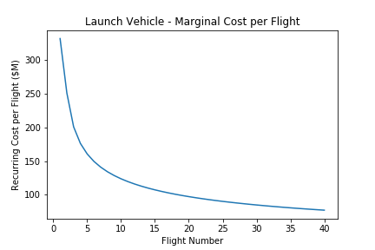
Average Marginal Cost per Flight: SSTO ELV

Slide 29
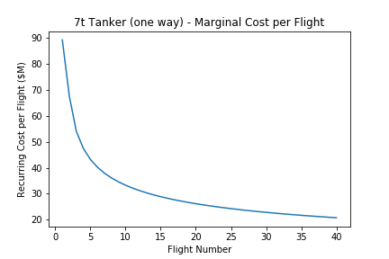
Average Marginal Cost per Flight: 7t Tanker

Slide 30
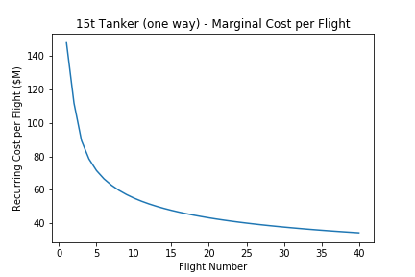
Average Marginal Cost per Flight: 15t Tanker

Slide 31
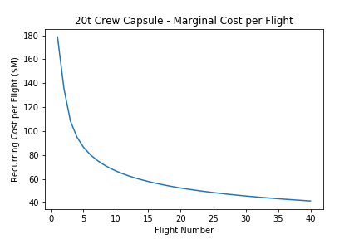
Average Marginal Cost per Flight: 20t Crew Vehicle

Slide 32
Conclusions
Single-stage to anywhere architecture is a good analytical starting point but quickly proves its limitations.
Lower marginal cost for SSTO offset by high non-recurring cost (due to high inert mass)
Round-trip mission architecture for lunar vehicle initial staging has lower marginal cost but higher total cost, including higher NRE costs, but the additional crew abort modes provided justify the higher cost.

Slide 33
Future Studies
Design Mini-SpaceBus to transport smaller payloads to lunar surface for Phase I uncrewed missions
Optimize Earth-Moon trajectory to minimize Δv, propellant mass requirements
Explore multi-stage LLV concept for optimization of propellant mass requirements
Add additional redundancies and abort modes into mission architecture to reduce risk of loss of mission and/or loss of crew

Slide 34
Back-up
For reference only

Slide 35
Mission Architecture (One-way)
Launch # | Mission Profile | Launch # | Mission Profile
1 | Scout Rover | 15 | SpaceBus Tanker
2 | Scout Rover | 16 | SpaceBus Tanker
3 | ISRU Plant Supplies | 17 | SpaceBus Tanker
4 | ISRU Plant Supplies | 18 | SpaceBus Tanker
5 | ISRU Plant Supplies | 19 | SpaceBus Tanker
6 | Lunar Landing Vehicle | 20 | SpaceBus Tanker
7 | SpaceBus Tanker | 21 | SpaceBus Tanker
8 | SpaceBus Tanker | 22 | SpaceBus Tanker
9 | SpaceBus Tanker | 23 | Crew Launch/Entry
10 | SpaceBus Tanker | 24 | Crew Launch/Entry
11 | SpaceBus Crew Transport | 25 | Crew Launch/Entry
12 | SpaceBus Tanker | 26 | Crew Launch/Entry
13 | SpaceBus Tanker | 27 | Crew Launch/Entry
14 | SpaceBus Tanker

Slide 36
Mission Architecture (Round-trip)
Launch # | Mission Profile | Launch # | Mission Profile | Launch # | Mission Profile
1 | Scout Rover | 15 | SpaceBus Tanker | 29 | SpaceBus Tanker
2 | Scout Rover | 16 | SpaceBus Tanker | 30 | SpaceBus Tanker
3 | ISRU Plant Supplies | 17 | SpaceBus Tanker | 31 | SpaceBus Tanker
4 | ISRU Plant Supplies | 18 | SpaceBus Tanker | 32 | SpaceBus Tanker
5 | ISRU Plant Supplies | 19 | SpaceBus Tanker | 33 | Crew Launch/Entry
6 | Lunar Landing Vehicle | 20 | SpaceBus Tanker | 34 | Crew Launch/Entry
7 | SpaceBus Tanker | 21 | SpaceBus Tanker | 35 | Crew Launch/Entry
8 | SpaceBus Tanker | 22 | SpaceBus Tanker | 36 | Crew Launch/Entry
9 | SpaceBus Tanker | 23 | SpaceBus Crew Transport | 37 | Crew Launch/Entry
10 | SpaceBus Tanker | 24 | SpaceBus Tanker
11 | SpaceBus Tanker | 25 | SpaceBus Tanker
12 | SpaceBus Tanker | 26 | SpaceBus Tanker
13 | SpaceBus Tanker | 27 | SpaceBus Tanker
14 | SpaceBus Tanker | 28 | SpaceBus Tanker

Slide 37
Lunar Landing Vehicle
Ascent
Liftoff Mass
Crew module
2x Engine+plumbing
Landing legs
Tank volume
Descent propellant
Ascent propellant
Transfer propellant
Tank insulation
Tank pressurization system
Avionics
Wiring
Ascent propellant
Transfer propellant
Descent propellant
Final Mass
Crew module
2x Engine+plumbing
Landing legs
Tank volume
Descent propellant
Ascent propellant
Transfer propellant
Tank insulation
Tank pressurization system
Avionics
Wiring
Transfer propellant
Descent propellant
Descent
Initial Mass
Crew module
2x Engine+plumbing
Landing legs
Tank volume
Descent propellant
Ascent propellant
Transfer propellant
Tank insulation
Tank pressurization system
Avionics
Wiring
Descent propellant
Landing Mass
Crew module
2x Engine+plumbing
Landing legs
Tank volume
Descent propellant
Ascent propellant
Transfer propellant
Tank insulation
Tank pressurization system
Avionics
Wiring
LO₂
Transfer propellant
Ascent propellant
Descent propellant
LH₂
Transfer propellant
Ascent propellant
Descent propellant
Note: figures not to scale

Slide 38
LO₂ Tank
LH₂
LH₂ Tank

Slide 39
